Slide 1
Iteration1 of Team5
CVCoach
Linchen Xu, Lin Ma, Zhen Cao, Zihan Zhou, Chenhao Sun

Slide 2
Team member

Slide 3
Overview
From requirement to development
Demo video of our project
Plan for iteration 2
(Video) Our development workflow

Slide 4
Overview
Iteration 1 target:
Finish Resume Evaluation
Current progress:
Reached our milestone
Issues:
Integrate Google login.
Training data for JD evaluation.
Notes:
We did a lot of stuff beyond the milestone, especially in the term of Configuration

Slide 5
From requirement to development

Slide 6
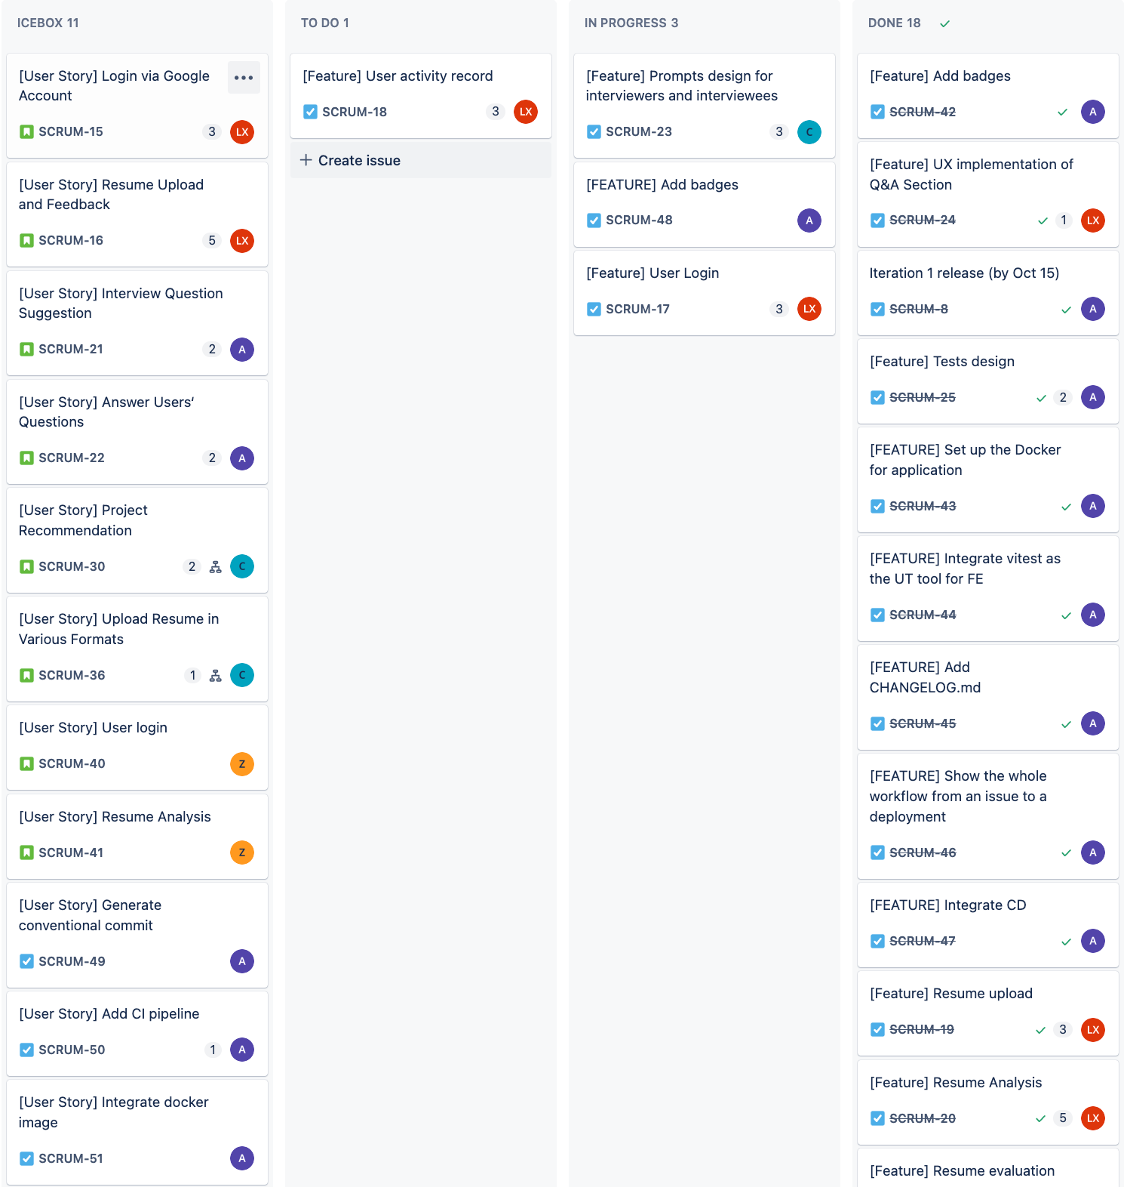
Tasks on JIRA
11 User Stories
1 in TODO
2 in IN PROGRESS
19 in DONE

Slide 7
[User Story] Resume Analysis
As a job seeker,
I want to upload my resume and receive feedback on how well I match a specific job description,
so that I can understand my strengths and areas for improvement to increase my chances of getting the job.

Slide 8
Acceptance Tasks
Successful Upload of Different Resume Formats
Given: The user is on the resume upload page and has a resume in PDF format.
When: The user selects the PDF file and clicks the "Upload" button.
Then: The system should successfully upload the resume and display a confirmation message indicating the PDF file has been successfully uploaded.
Upload Unsupported Resume Format
Given: The user is on the resume upload page and has a resume in an unsupported format (e.g., TXT).
When: The user selects the TXT file and clicks the "Upload" button.
Then: The system should reject the upload and display an error message indicating that the file format is not supported.

Slide 9
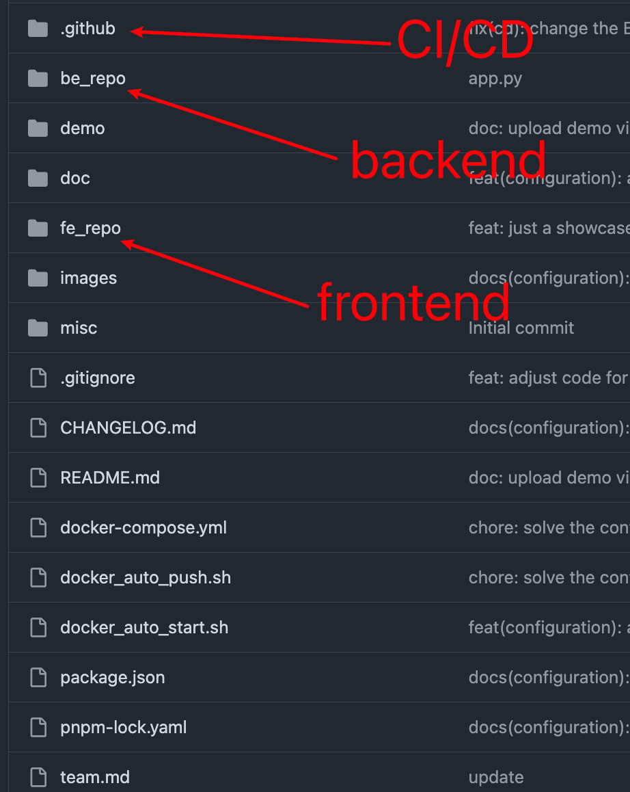
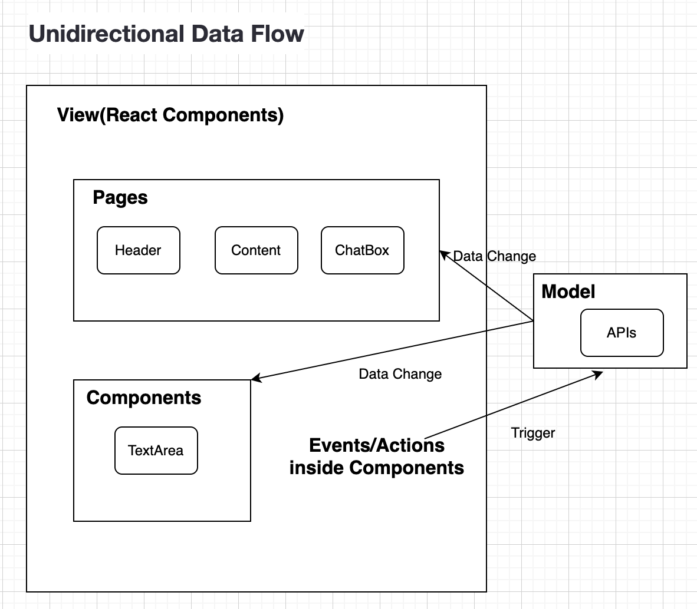
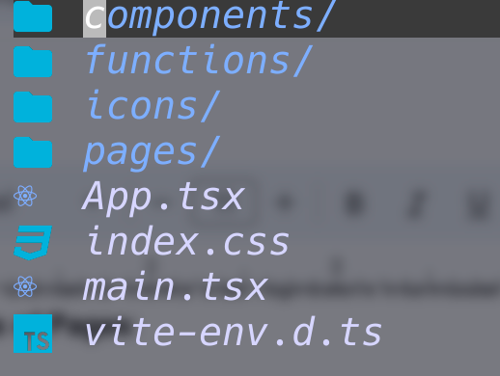
Software architecture - Frontend

Slide 10
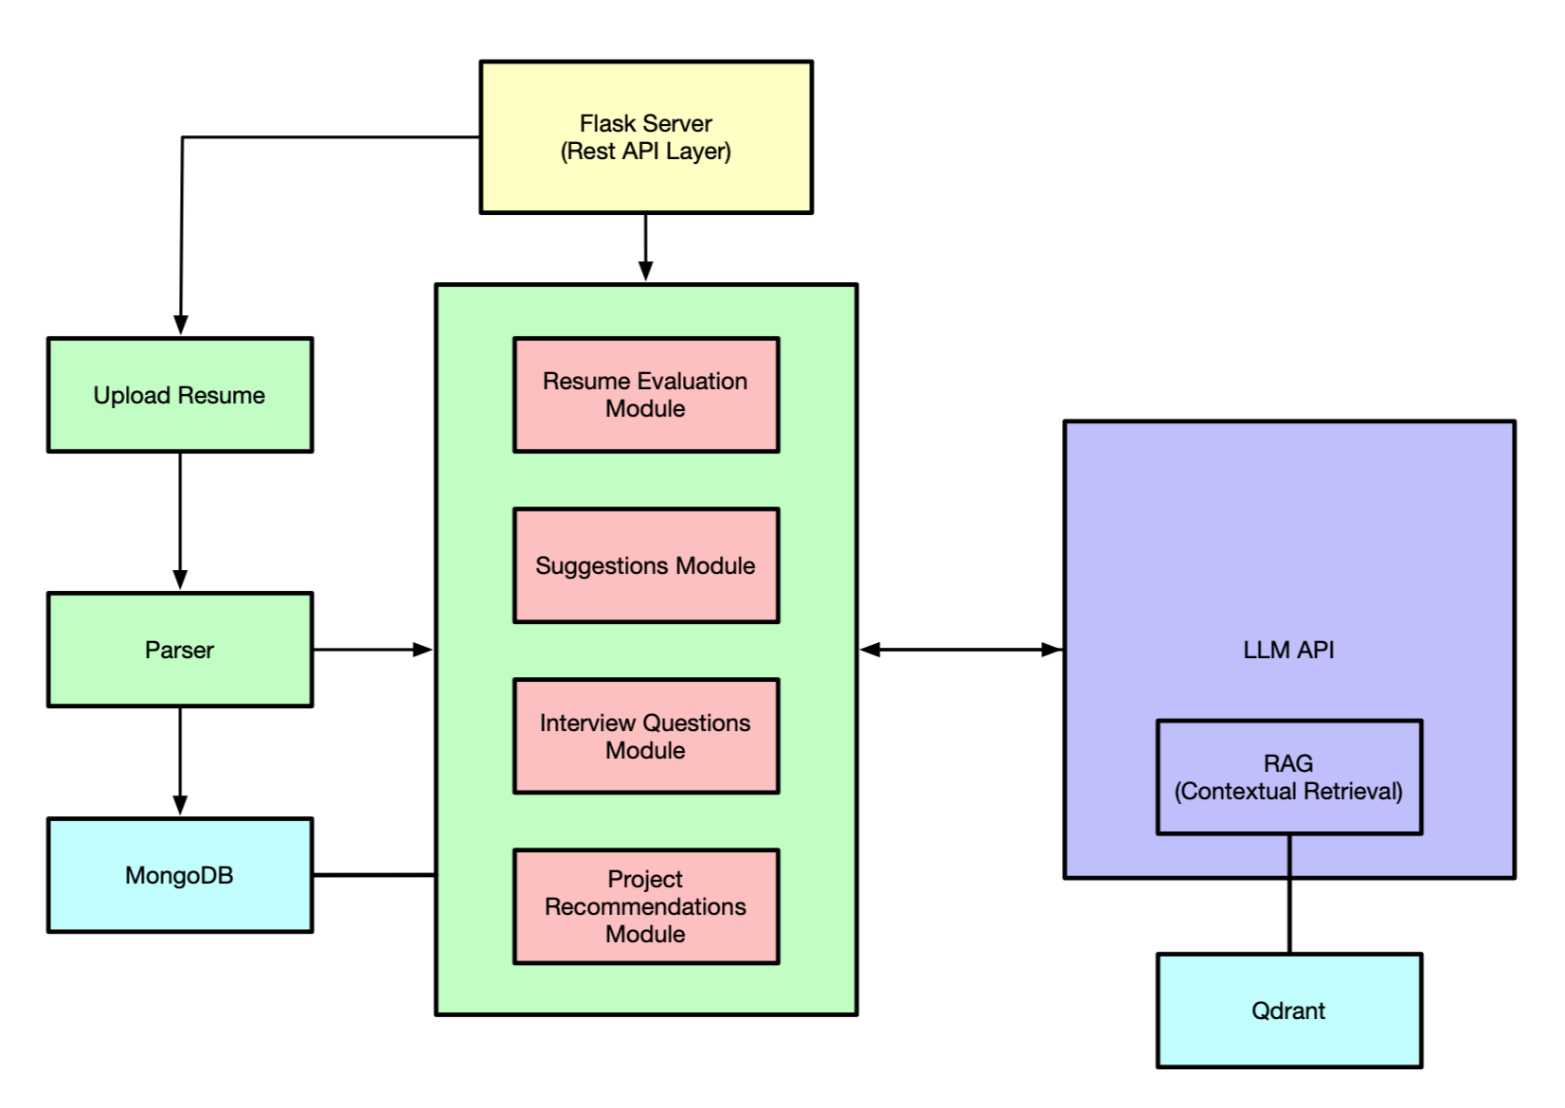
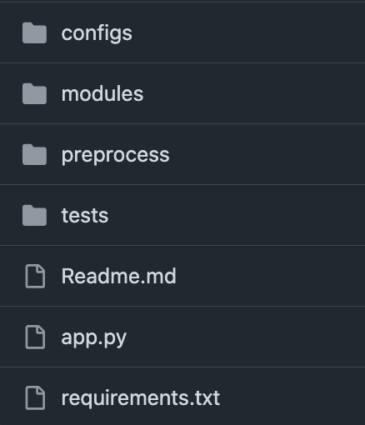
Software architecture - Backend

Slide 11
Resume
EDUCATION
—----------------
—--------------
SKILLS
—------------------
—----------
—------------
—---------
WORK EXPERIENCE
—---------------------------------
—--------------------------------
ACADEMIC PROJECTS
—------------------------------------------------------
—-------------------------------------------------------
—-------------------------------------------
Prompt
LLM
Some Criteria
Relevance of Job Description
Achievements and Impact and Certifications
Resume Structure and Presentation
Soft Skills
Consistency and Chronology
Weighted Score
Explanation

Slide 12
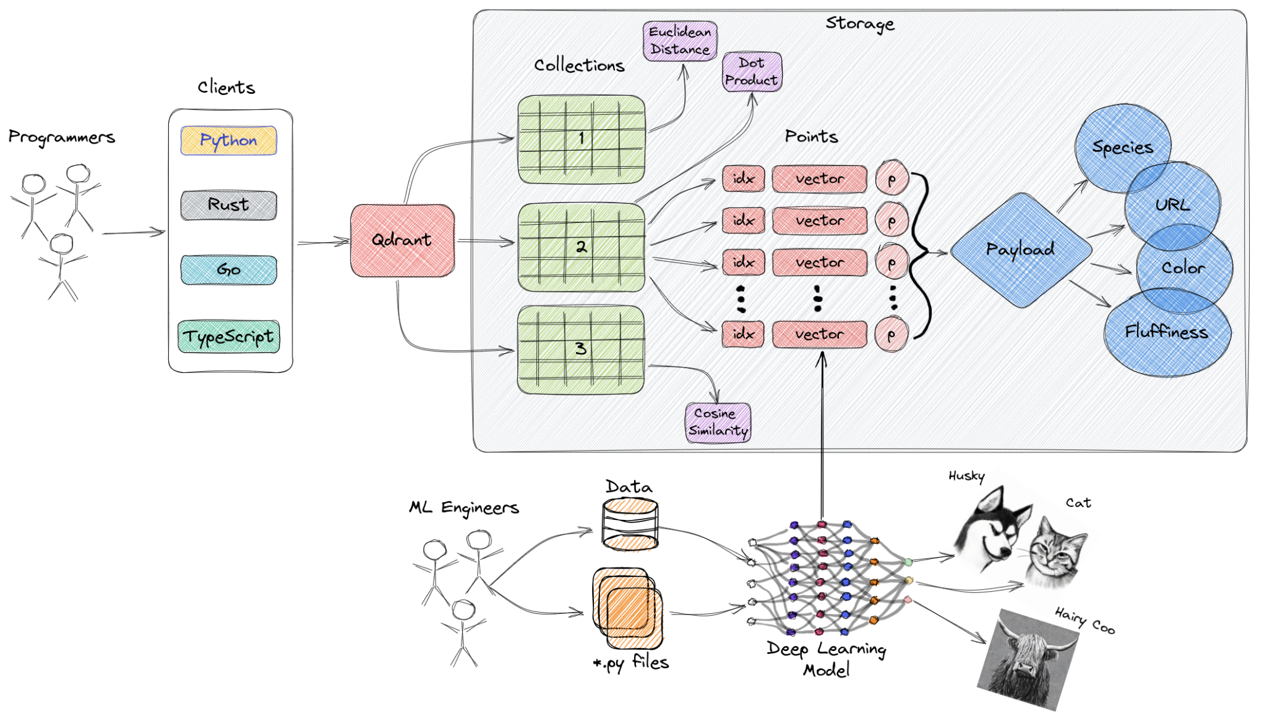
Qdrant, A vector database

Slide 13
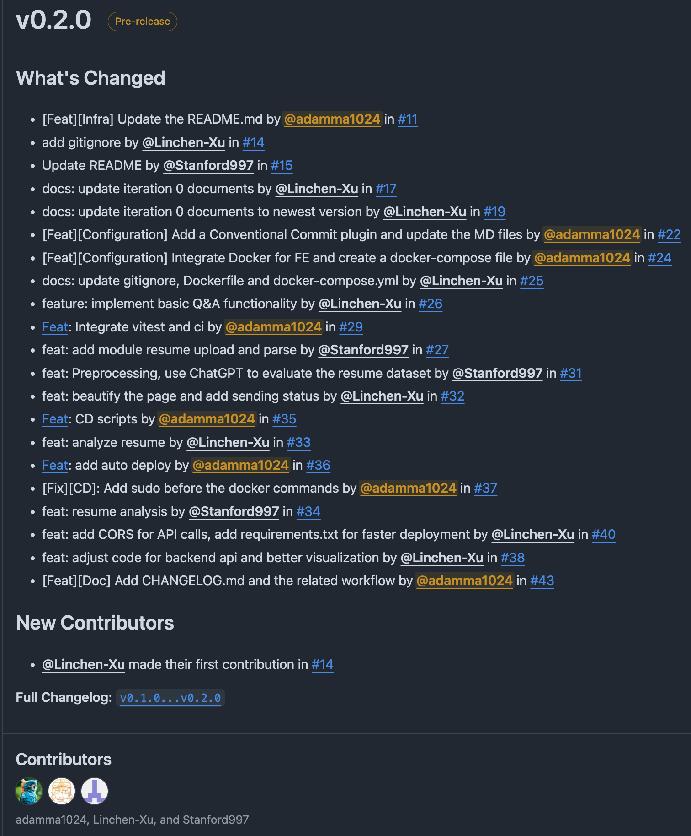
PRs and commits
21 PRs for the Release v0.2.0(iteration1)

Slide 14
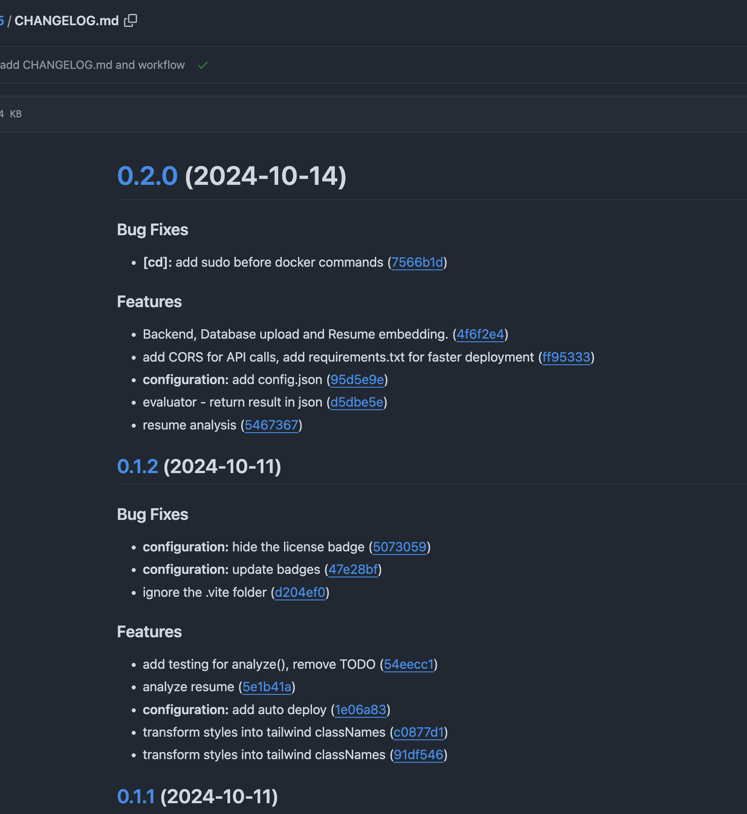
PRs and commits
7 Bug fixes
31 Features
collected by the CHANGELOG

Slide 15
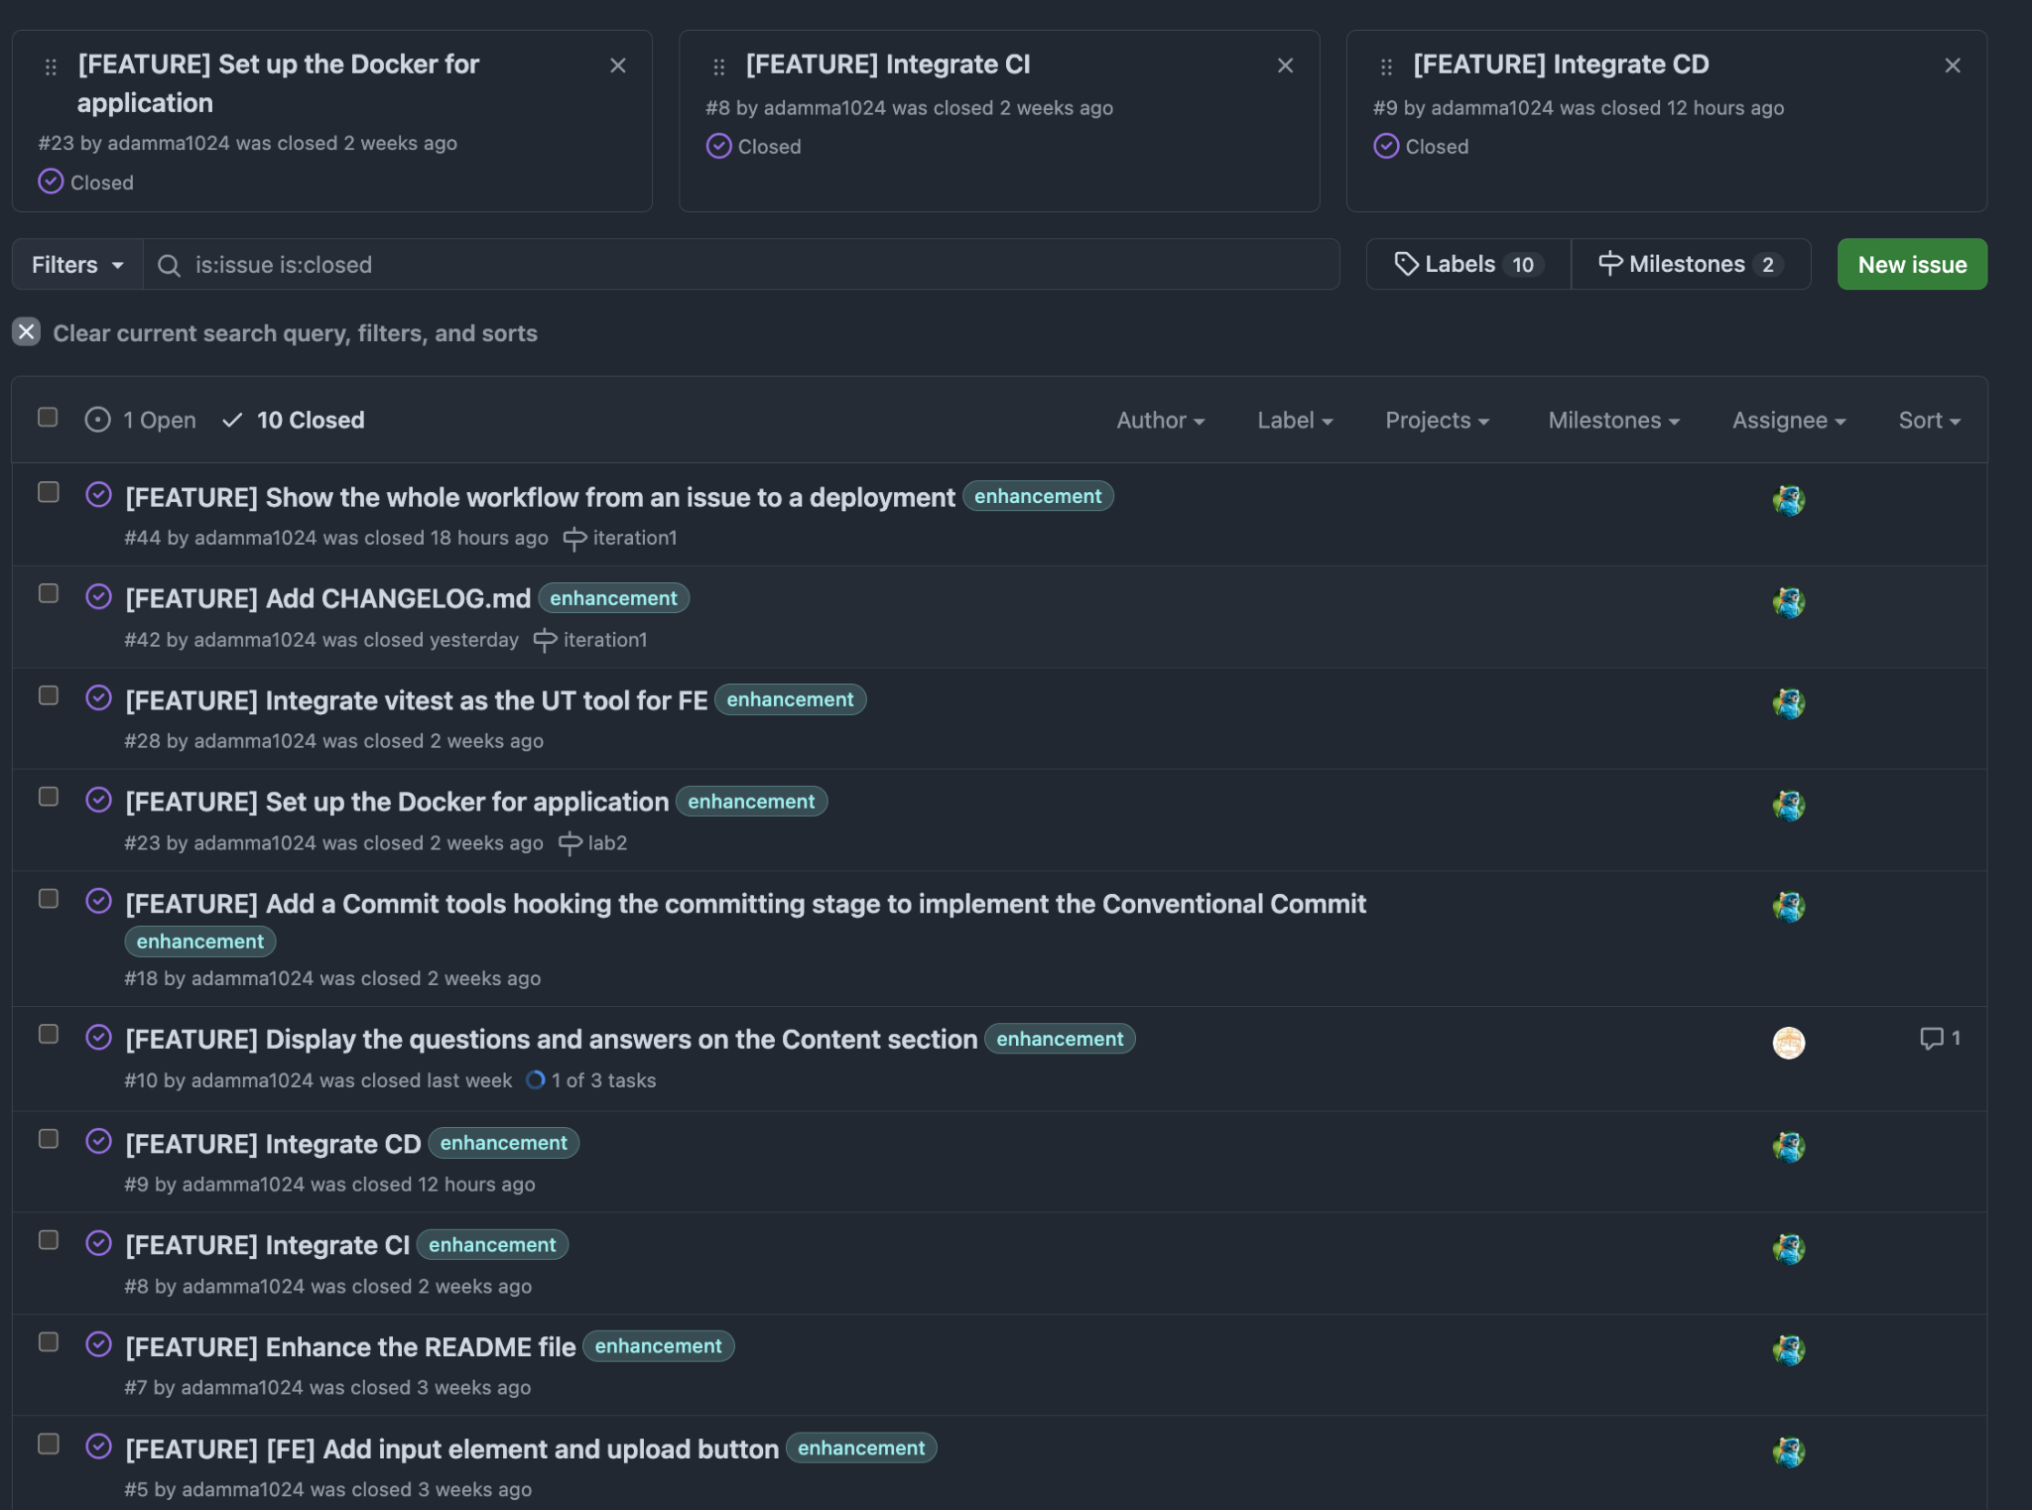
Issues
1 Open
10 Closed
Notes:
By the way, I don’t want to maintain the JIRA anymore. Because maintaining the JIRA and Github issues at the same time is really painful. These are a lot of redundant works. I wonder if I can entirely use Github issues to track tasks.

Slide 16
Demo Video for our project

Slide 17
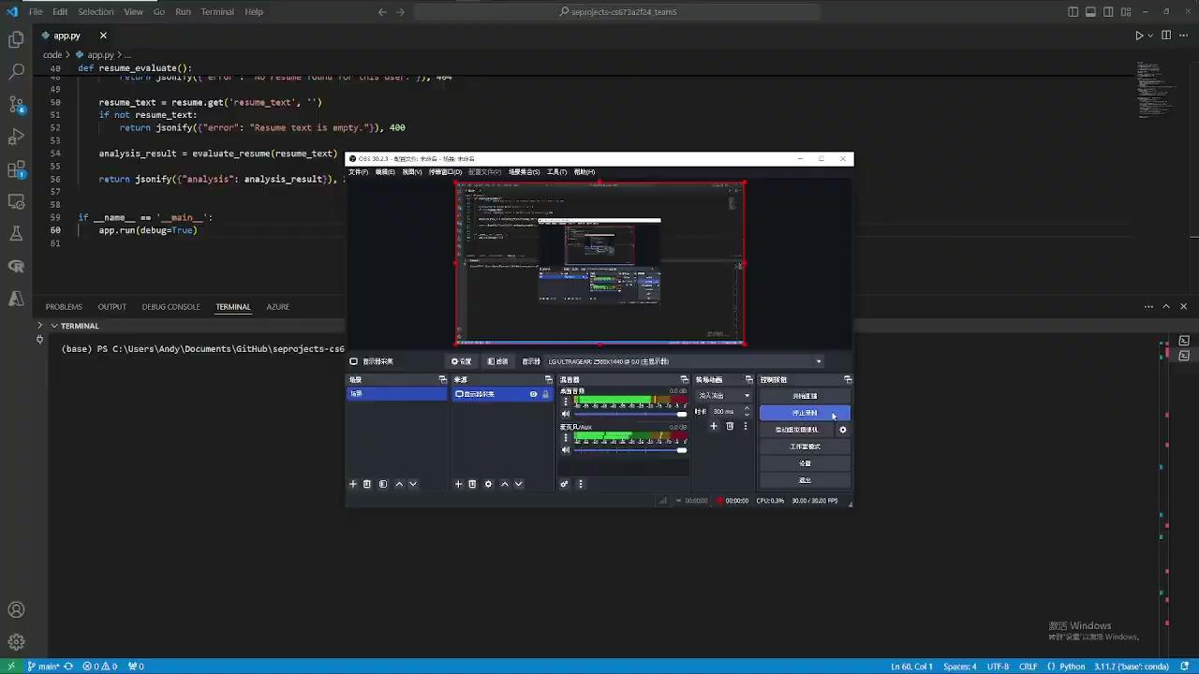

Slide 18
Plan for iteration 2

Slide 19
User Stories
Answer user’s questions
Evaluate the resume with JD

Slide 20
Roadmaps of Security and Testing
Integration of Cloudflare to keep our DNS safe from attacks like DDoS
Dependencies checking (in CI)
Input filter, avoid the XSS attack.
Isolate the privacy data from the request and even tracking.
Isolate the sensitive user data from RAG retrieval.

Slide 21
(Video) Our development workflow

Slide 22
What’s your solutions for the essential difficult of SE?
How did they work in your repo?
Complexity, Changeability, Conformity, Invisibility

Slide 23
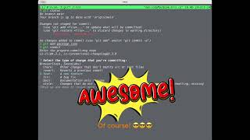

Slide 24
Complexity
Divide and Conquer: Use architectures to break down and optimize the constructor of folder.
Code review to ensure there are no bad smell codes.
Changeability
CI: Auto testing, Linters, building.
Conformity
Linters - conformity of code style
Documentation: To make sure developers are in the same page
Communication: PR Review, Discord or other IM tools
Invisibility
CD: To deploy a visible service for testers.
Monitoring, Logging, add some runners or loggers to monitor if your site is healthy. If not, you'll receive alerts on your mailbox. (TODO)

